Slide 1
Contact Network Patches what are they, and what is their significance
Tashi Sherpa
Notes:
My name is Tashi Sherpa, I am going to be discussing more about contact network patches.

Slide 2
What are contact networks
Contact Network Classification
Real-World Analysis
Bibliography
Notes:
We will try to review a bit about what are contact networks, then try to define contact network models to have a better idea of the classifications of contact networks, and then we’ll visit a real-world example.

Slide 3
A contact network is a network represented with links that represent “spreading processes” or interactions between two nodes.
Though they are usually modeled in a biological context, the “spreading processes” part can carry over to the digital or social space as well.
Notes:
What are contact networks? <Read the definition, then the bottom part>

Slide 4
Examples of Contact Networks
Notes:
Based on the definition, can anyone come up with some examples of a contact network in real life?

Slide 5
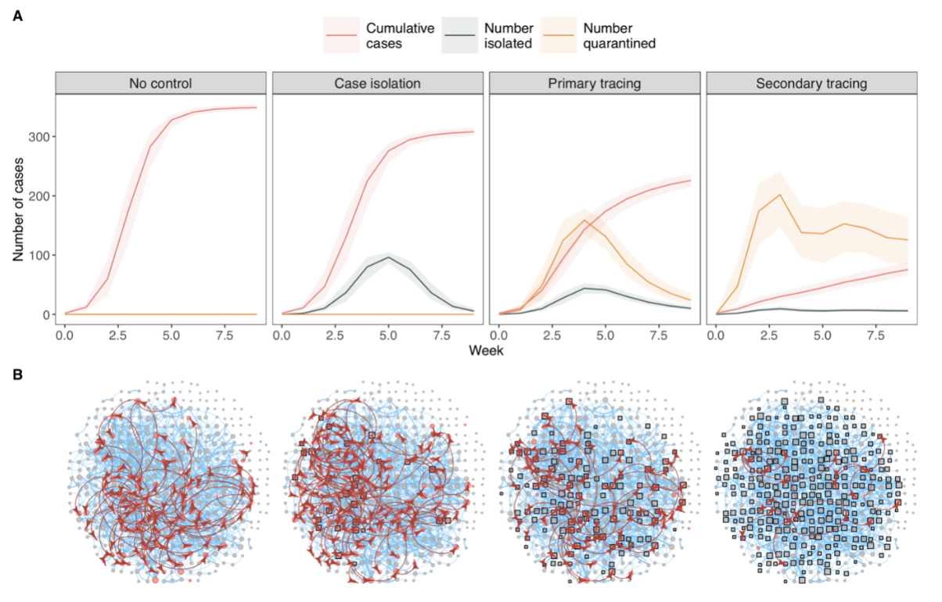
Examples of Contact Networks
COVID-19 contact network
Biological
(Spread of diseases)
src: https://cmmid.github.io/topics/covid19/tracing-network-local.html
Notes:
There are biological contact networks, aka the spread of pathogens or disease. This is the most common contact network example. Here, we have a COVID-19 contact network with a contact network model (we will talk about that later). Here, you see that in simulations where people take more preventative measures (from isolating themselves when infected to quarantining once, or even twice based on suspicion, the cumulative cases decreases.

Slide 6
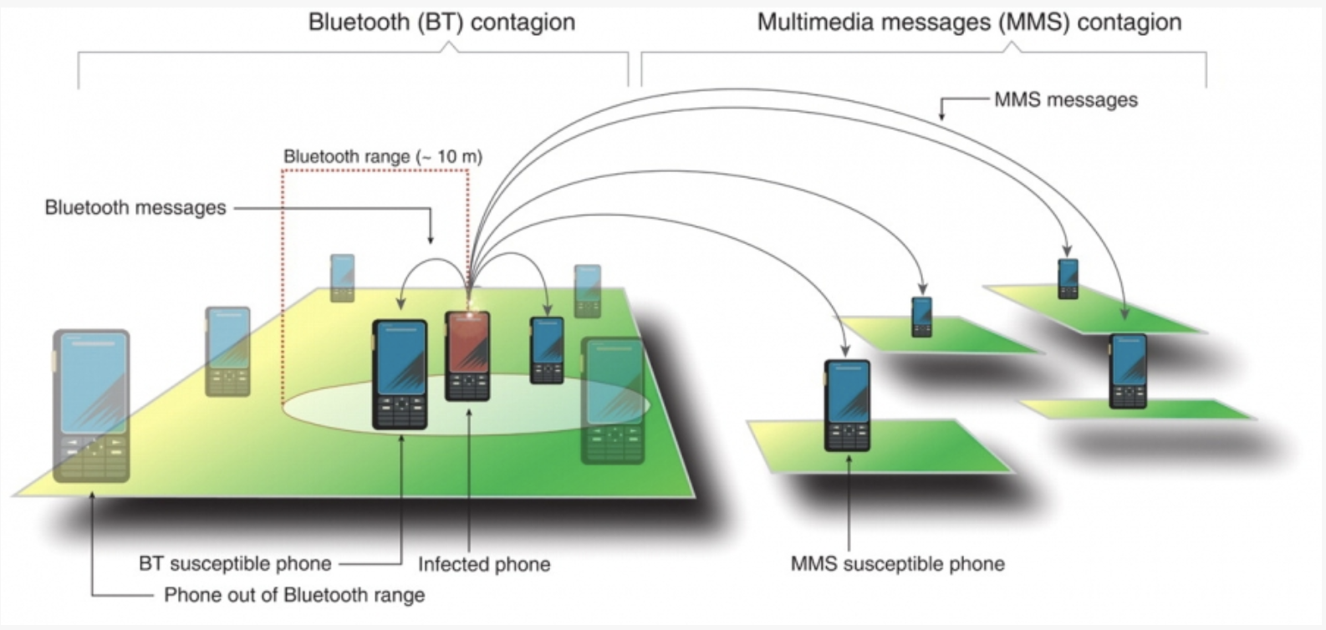
Examples of Contact Networks
Digital
(spread of computer viruses)
src: Network Science by Albert László-Barabási
Notes:
Another example are digital contact networks. In this example, phones in a “bluetooth” radius of about 10m are all possible nodes that can become “infected” due to the infected phone’s spread. In the MMS example, there are no distance limitations, but instead limitations based on messaging.

Slide 7
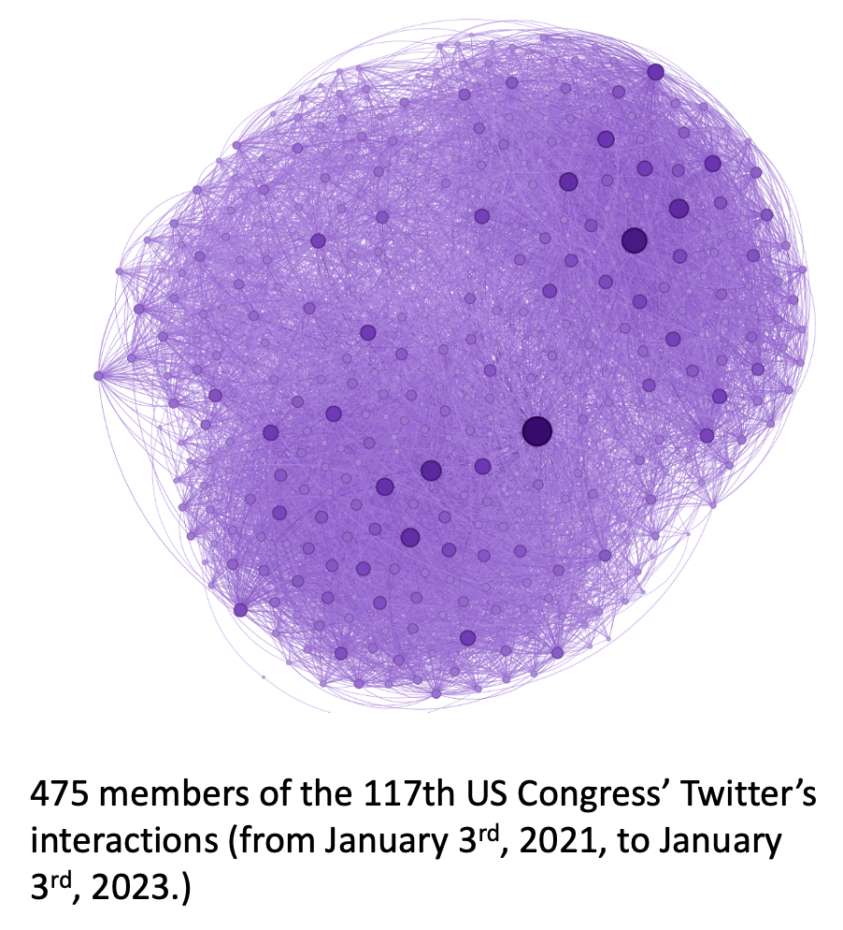
Examples of Contact Networks
Social
(spread of content or ideas on social media)
src: my network science assignment 1 - twitter network (SNAP)
Notes:
Last example, social contact networks. This can be anywhere from a company spreading a product idea to customers, to an internet meme. Here, we’re talking about social media content in the US Congress (this was my assignment 1, I got this network from the SNAP repository).
Mention how contact networks are everywhere, very broad definition, synonymous with “epidemic” (real-world interactions between nodes that have a form of “contagion” and a variable of time).

Slide 8
Characteristics of a contact network
Synonymous with network epidemics
In some contexts (especially biological ones) there are also immune and latent nodes.
Note: “individual” can be substituted here depending on network context.
Notes:
Read slide, you can think of contact networks’ spread as “contagion”, almost like an epidemic. Three types of epidemic models: explain them. Read slide.

Slide 9
Contact Networks - Modeling?
With the compartmentalization of individuals or nodes, we introduce the variable of time.
This introduces the concept of modeling the network as a metric of time.
For the sake of generalization, these models are built on the idea of the homogenous mixing hypothesis (each node’s p or probability of encountering an “infected” node is equally likely - any node can infect any other node with equal probability).
Notes:
Talk about some terms - time -> segue to modeling networks based on time elapsed.
Read slides.

Slide 10
Contact Networks - Modeling? cont.
Some notes:
Nodes will be treated as “individuals”.
Contact Network modeling is biological-centric - models will revolve around around pathogen spread.
We are looking to understand the network - rate of infection at time t.
Notes:
Read slides here.

Slide 11
Contact Networks - Modeling? cont.
Some notes:
Nodes will be treated as “individuals”.
Contact Network modeling is biological-centric - models will revolve around around infection of pathogens.
We are looking to understand the network - rate of infection at time t.

Slide 12
What are contact networks
Contact Network Classification
Real-World Analysis
Bibliography
Notes:
Now we’ll talk about how we can classify these various contact networks into specific models.

Slide 13
Contact Network Models
Susceptible-Infected-Recovered Model
Susceptible-Infected Model
Susceptible-Infected-Susceptible Model
Notes:
We’ll be talking about these three models. There are more models for modeling contact networks, but these three are simple and capture a good amount of what’s used and talked about in contact network research.

Slide 14
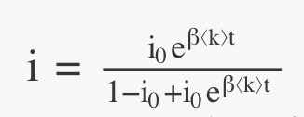
Susceptible-Infected Model
The simplest model - exhibits two of the three compartments / states:
Susceptible individuals, denoted as S(t)
Infected individuals, denoted as I(t)
Notes:
First model (talk) -> go to next page and explain each component.

Slide 15
Susceptible-Infected Model
<k> = average number of “connections” an individual has.
s(t), i(t) = fraction of the susceptible and of the infected population at time t. [s(t) = s, i(t) = i]
i0 = i(t = 0) (fraction of infected individuals at t = 0)
Notes:
Mention s(t) and i(t) are annotated from now on to s and i, respectively.

Slide 16
Susceptible-Infected Model
β<k> = The product of β (rate) and <k>, transmission rate / transmissibility.
τ = the characteristic time (time to reach a 1/e fraction of susceptible individuals (~ 36%) ).
di/dt = rate of change of i (the fraction of infected population over time).
Notes:
B<k> = transmission rate (product of rate and average neighbors in network)
Tau = characteristic time, aka time it takes for 36% of the population to be susceptible.
di/dt rate of change of i, fraction of infected population over time.

Slide 17
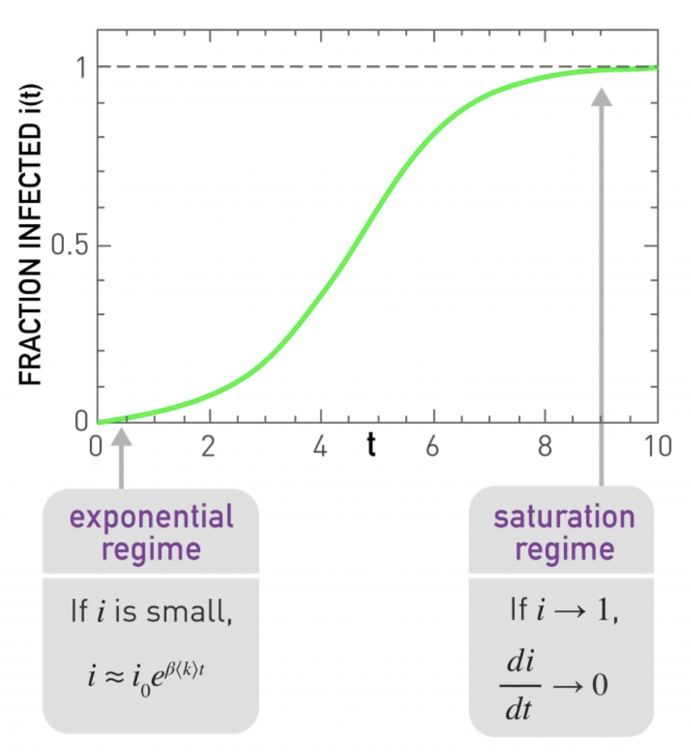
SI-Model Image
Only two states, susceptible and infected.
Resembles sigmoid function.
When there’s a low fraction of the infected population (i), scales based on time and transmission rate.
This gradually slows down - eventually everyone is infected (i(infinity) = 1).
Notes:
Talk about exponential and saturation regime here.
Sigmoid function resemblance.
i(infinity) = 1.

Slide 18
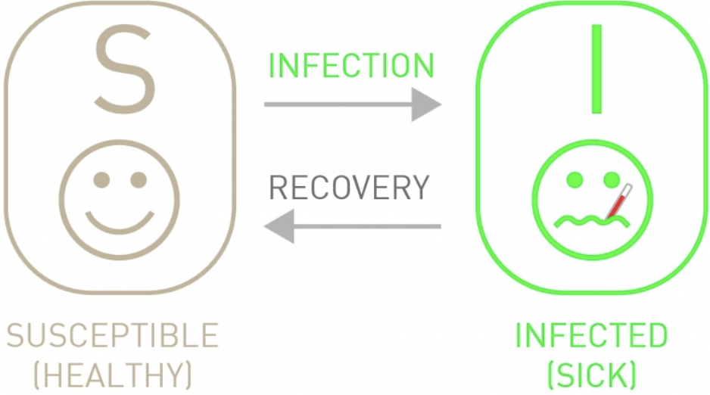
Susceptible-Infected-Susceptible Model
New variable - individuals can recover!
This allows for a possibility such that the disease stops spreading before i = 1.
μ = the rate at which infected individuals recover.
Notes:
Next model - talk about diagram, how individuals can recover.
Explain mu = rate at which infected individuals can recover (thus become susceptible again).

Slide 19
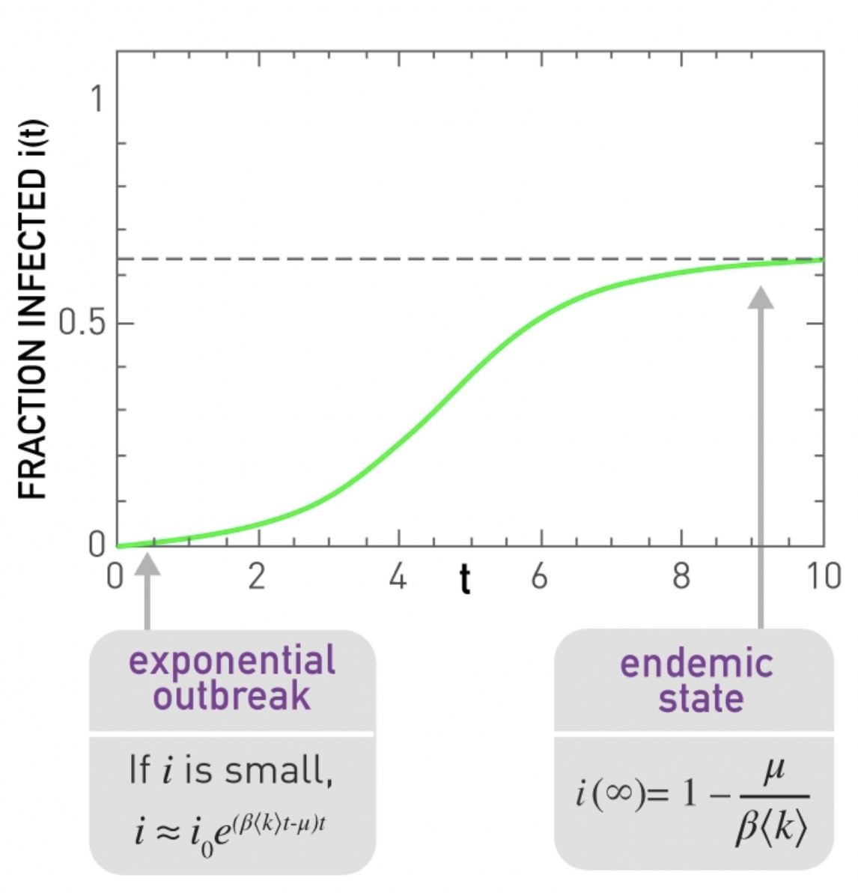
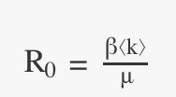
SIS-Model Image
Due to recovery, i(infinity) < 1, so long as the recovery rate > 0.
Endemic state: when i(infinity), if there’s recovery, converges at < 1.
Disease-Free state: when recovery rate > transmission rate, the curve has a negative slope.
R0 = basic reproductive number.
Like a “spread” measure.
Notes:
Talk about exponential outbreak, endemic state, and disease-free state. Talk about how R0 = average number of susceptible individuals infected by an infected individual, assuming a fully susceptible population (exponential outbreak, ideal) Talk about how if R0 < 1, infection dies out (more recovered), if R0 > 1, spreads and persists. R0 = 1, infection does not always spread (what does this mean?)

Slide 20
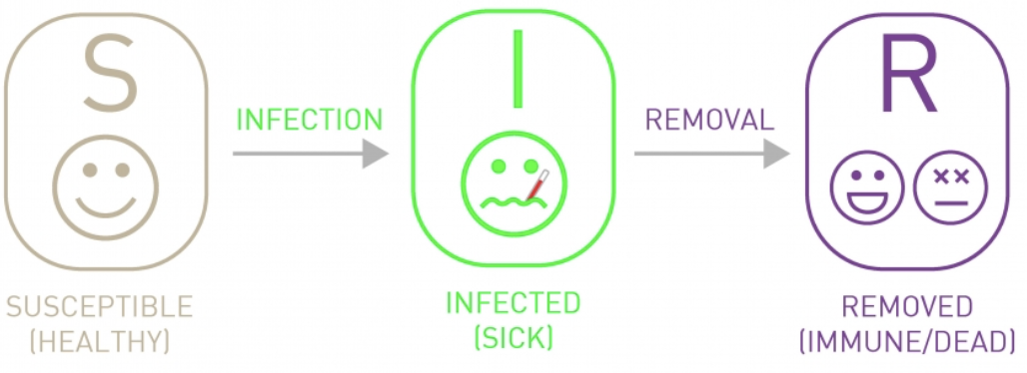
Susceptible-Infected-Recovered Model
All three states / compartments: susceptible, infected, and recovered.
Recovered = removed, individuals that cannot be infected or infect others (either immune or dead).
No cycle between susceptible and infected, after infection, individuals / nodes become recovered.
Notes:
Talk about the next addition - third state or compartment.
Explain what recovered is - “removed”.
Highlight no cycle.

Slide 21
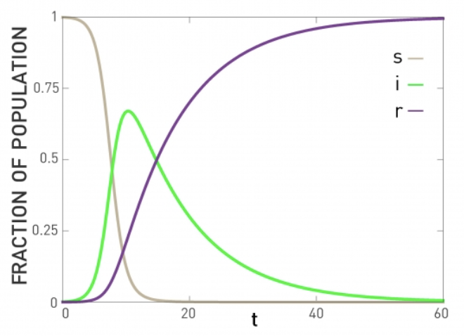
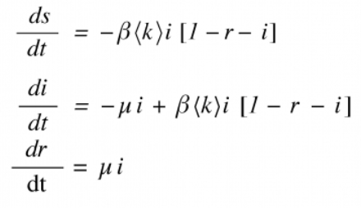
SIR-Model Image
Notes:
Talk about how overtime, when i(infinity), i = 0, r = 1, s = 0 (everyone becomes recovered). Talk about here, mu’s recovery rate now transitions straight to r or recovered, not back to susceptible.

Slide 22
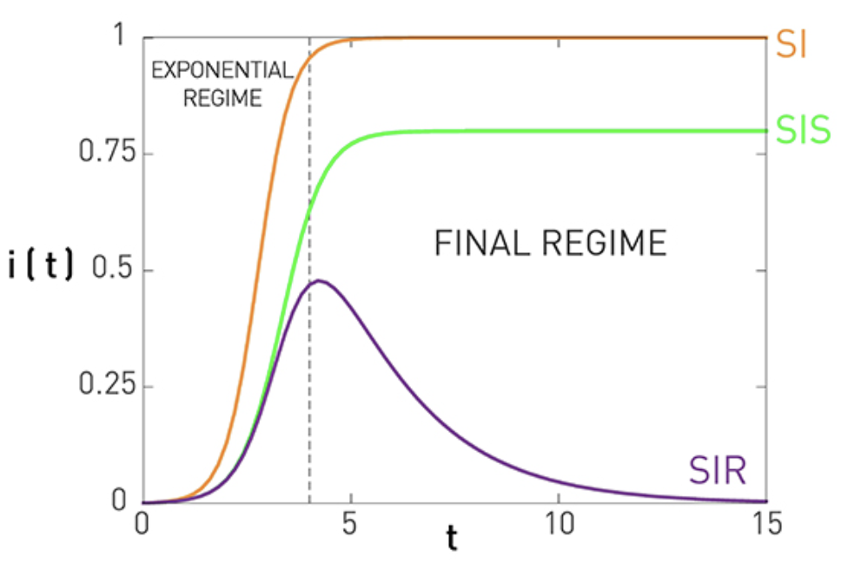
Model Comparison
Notes:
Talk about what the final regime is, i(infinity) (talk about how SIS and SIR model both capture R0, or basic reproductive number (transmission rate / recovery rate). Say that although some real-world biological networks (covid-19) are more complicated (mainly due to the lack of distinction between susceptibility and recovery - an individual can recover and become susceptible at a later period), these three models cover the basics and are still key in network science research.

Slide 23
What are contact networks
Contact Network Classification
Real-World Analysis
Bibliography
Notes:
Now we’ll be talking about a real-world example in-depth.

Slide 24
Air Transportation Network Example
Research article: The role of the airline transportation network in the prediction and predictability of global epidemics by Vittoria Colizza, Alain Barrat, Marc Barthêlemy, and Alessandro Vespignani
Modified International Air Transport Association database (2002) - 3100 largest airports, 17182 weighted directed edges (paired by direct flights).
Worldwide Airport Network (WAN)
Represents 99% of worldwide traffic.
Weight (wjl) = passenger flow between airports j and l.
Complemented with Nj and Xj[m](t), population at airport j’s city and number of individuals in the state / compartment [m] at time t.
Notes:
Read slides.

Slide 25
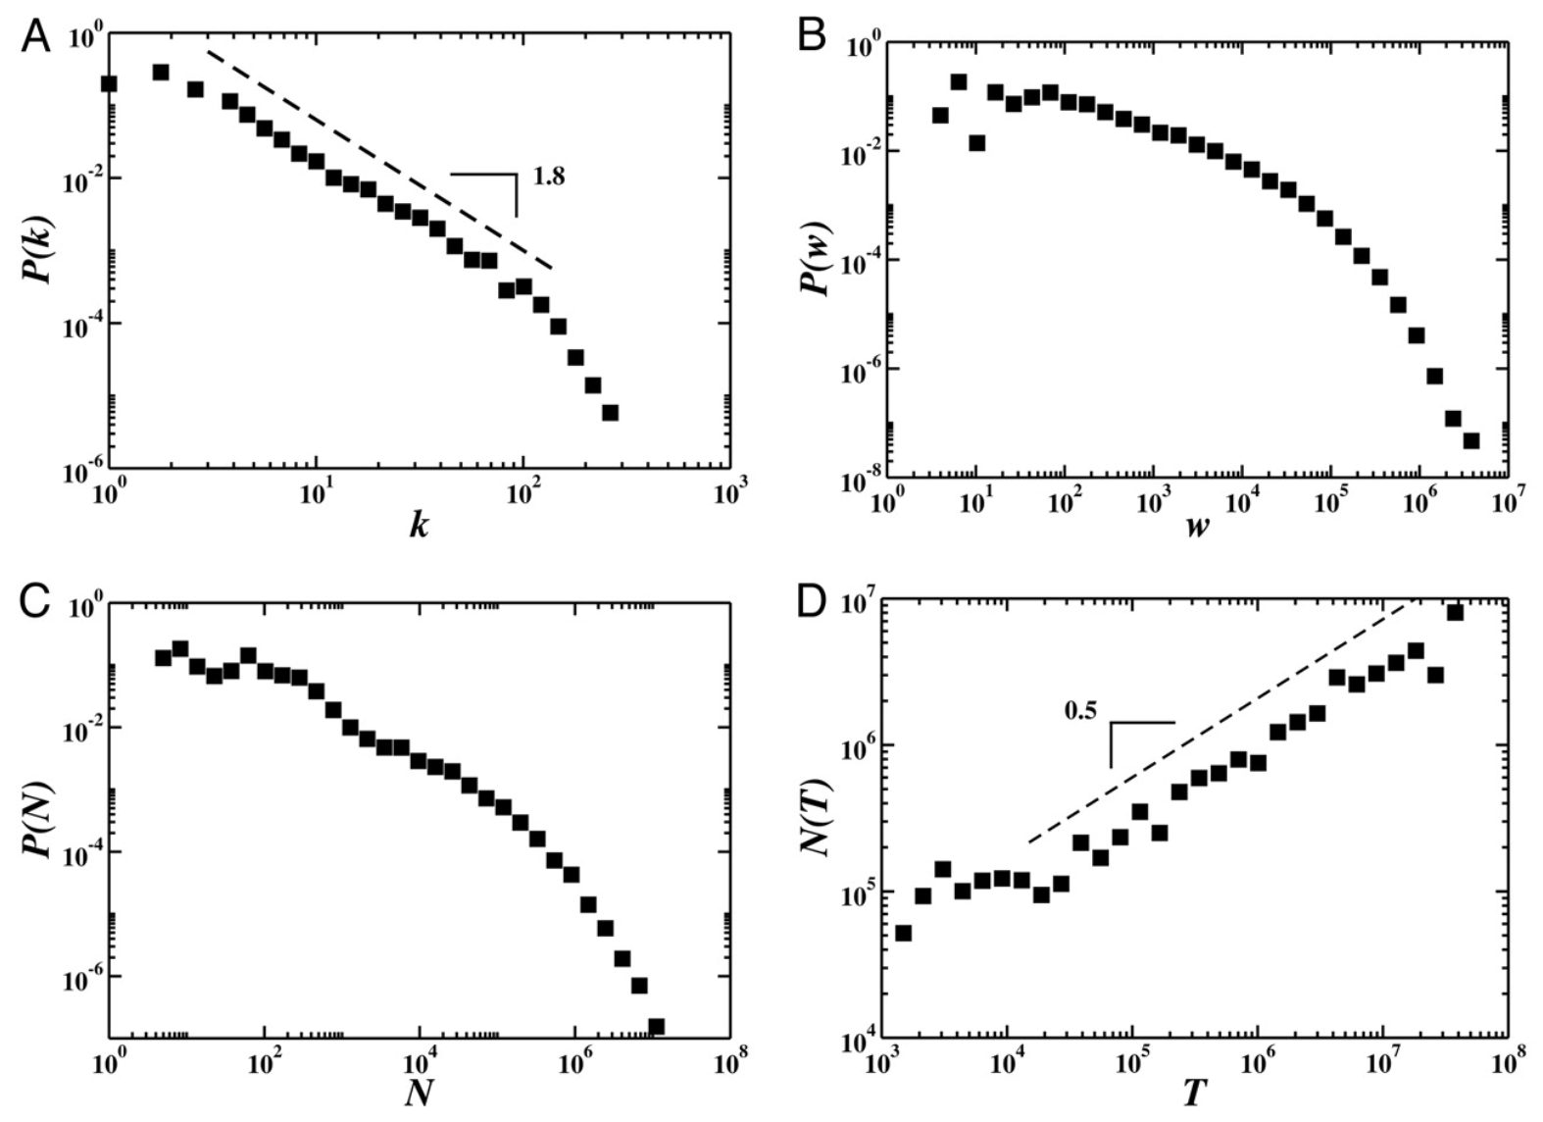
Worldwide Airport Network (WAN) properties
Traffic at airport i Ti ≈ k^β, where k = number of connections from airport i (β = 1.5)
Graphs A, B, and C all have heavy-tail, power-law behavior.
Graph D shows a positive strong correlation between traffic T and population N.
Conclusion: WAN mirrors properties of a scale-free network.
Notes:
Mention that researchers found some nonlinear associations, Ti approx k^B.
K = number of edges from airport i, w = weights, representing “passenger flow” or amount of activity between two airports, N = number of people in city surrounding airport i, T = traffic at airport i.
N(T) = population of airport i with traffic = T. Mention conclusion, say that we’ll explore this in a few slides.

Slide 26
Significance of WAN
With the World Airport Network, we can model pathogen spread.
Airport transportation is the driver for spreading susceptible, infected, and recovered individuals to different Ni, different populations.
Notes:
Read slide, also explain equation (easy, Nj = population of city served by the airport j, equals population of susceptible, infected, recovered).

Slide 27
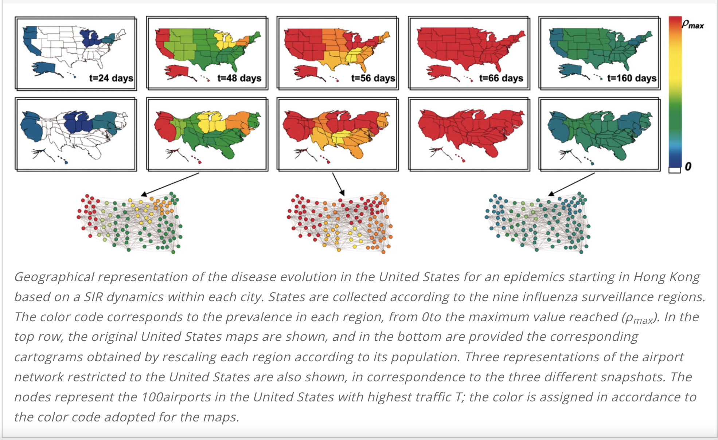
Influenza spread in the USA
Diagrammed with the SIR-Model.
Each node represents a major US airport, top 100 airports with most traffic.
p = prevalence, fraction of infected to total (Ij / Nj)
Notes:
Mention that this is influenza evolution in the US for an epidemic that started in Hong Kong. Mention the relation between the WAN and influenza spread, read slides.
Color coded by p = infection prevalence. Researchers showed three network-like representations (100 nodes = top 100 airports with most traffic in US).

Slide 28
WAN and Other Networks Analysis
The researchers introduced two more networks, HOMN and HETN (Homogenous Network and Heterogeneous Network, respectively).
HOMN network is an Erdos-Renyi random network, such that kj ~ <k>
HETN network reflects uneven distribution, degree distribution resembles a power-law.
New analysis tool: entropy - describes heterogeneity of a network.
Notes:
Read slides. Mention that entropy = H(T), V in the equation is the number of nodes or airports (vertices).

Slide 29
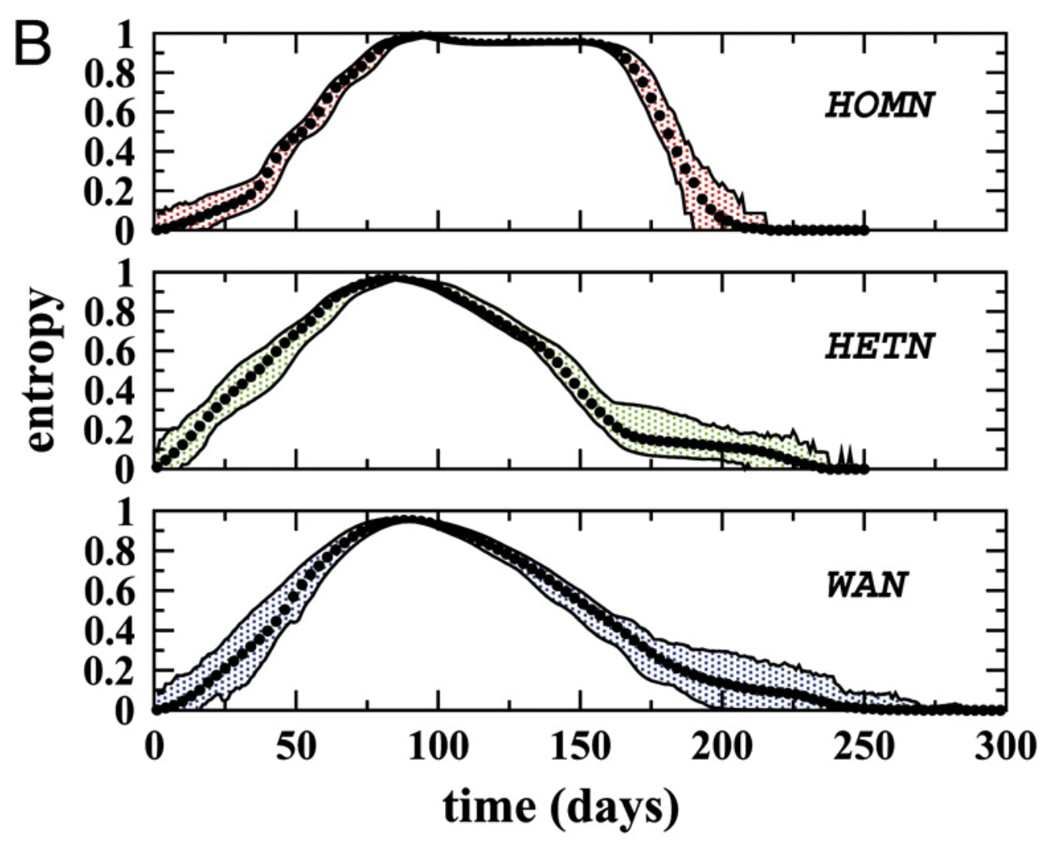
WAN and Other Networks Analysis cont.
All three networks were ran on multiple realizations / simulations (2 * 10^12 realizations)
HOMN has sharp changes of avg entropy in the beginning and end, with a longer persistence of entropy ~ 1.
HETN mirrors WAN, WAN mirrors scale-free behavior.
Notes:
Show that this is a culmination or average of 2 * 10^12 simulations, how homogenous had sharper and more dramatic changes, longer persistence at entropy ~ 1. Heterogenous and WAN are close, mirroring scale-free behavior.

Slide 30
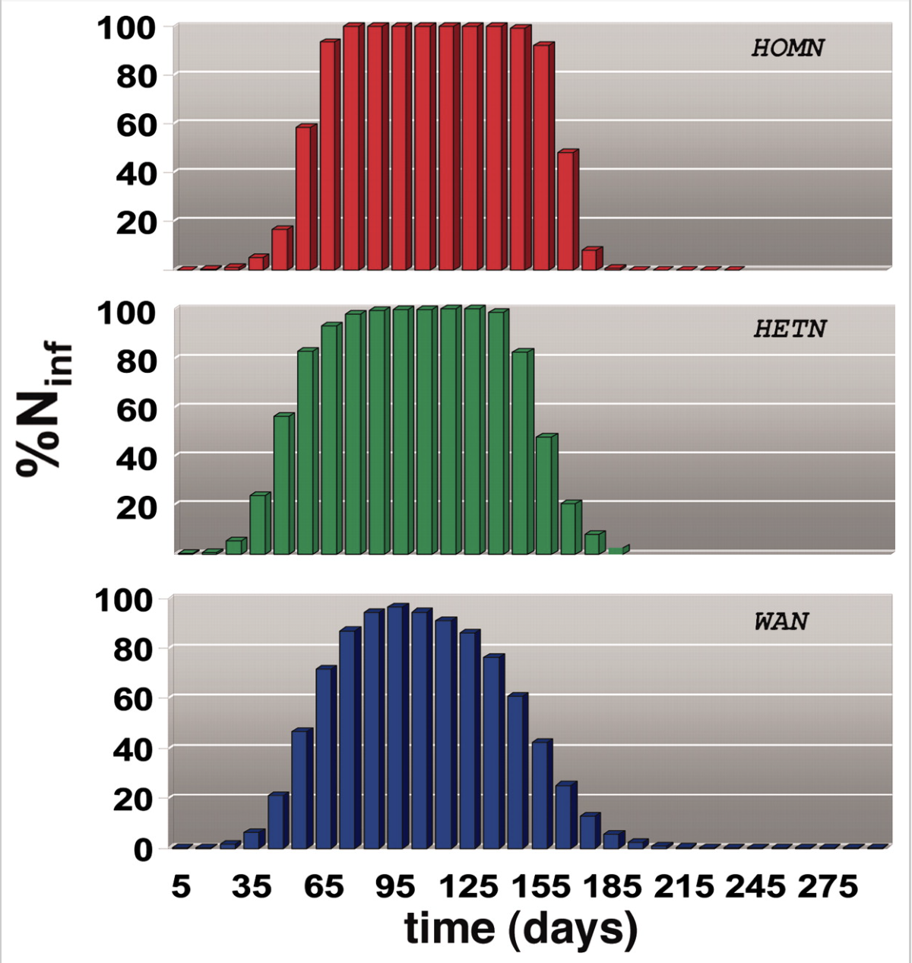
WAN and Other Networks Analysis cont.
Percent infected (single realization) mirrors entropy graphs.
Note: Why did the researchers model entropy?
Notes:
Talk about how when looking at percent infected, almost perfectly mirrors entropy - this is a good measure of pathogen spread - why? Answer - low entropy indicates less disorder, more controlled spread (di/dt closer to 0, or slower changes to infection curve) and more predictable. Higher entropy equals more disorder, exponential or possibly unknown spread (di/dt close to 1?, can also be erratic, sudden changes to curve)

Slide 31
WAN Influenza Modeling - Conclusions and Next Steps
Direct flight detail from WAN is responsible for global pattern in emerging diseases, not just influenza.
Mathematical models can show detailed “what-ifs” to detail forecast of emergent disease outbreaks.
Possibly work on other variables - variable (changing) transmission rate (geographical, seasonal, etc), other modes of transportation.
More modern airplane modeling? Possibly based on current events like COVID-19.
Notes:
Conclusions and next steps: Talk about how this is a 21 year old dataset (WAN), possibly want to see or maybe even look at 2023 WAN data and try to do a simulation on the outbreak of COVID based on 2023 airline data (on the USA maybe?)

Slide 32
What are contact networks
Contact Network Classification
Real-World Analysis
Bibliography

Slide 33
Bibliography
Network Science by Albert László-Barabási
Combining fine-scale social contact data with epidemic modelling reveals interactions between contact tracing, quarantine, testing and physical distancing for controlling COVID-19 by CMMID COVID-19 working group.
The role of the airline transportation network in the prediction and predictability of global epidemics by Vittoria Colizza, Alain Barrat, Marc Barthêlemy, and Alessandro Vespignani
Notes:
Any questions?

